Slide 1
Predicting Prospective Learner Success & Persistence at point of Inquiry (Lead Quality Score) (Mar 2013)
Opoku Adu-Gyamfi
Marketing Analytics

Slide 2
What is Lead Quality?
By leveraging data collected at the point of inquiry, we can predict with actionable accuracy the likelihood of a prospective learner to enroll, pass, and persist.
Business Impact:
Monitor leading indicator trends
Are we attracting the right prospects?
Are we converting the right prospects? Relationship of prospect to learner scores
Improve how we buy and target media
Real-time business relevant outcome metrics for optimization
Extending to consumer targeting via look-a-like in DMP/Display
Tailor the experience prior to enrollment
1:1 Relationship Marketing Segmentation - Selective customized messaging in email & direct mail
Prioritize ES resources & Sales Protocols - Model score influenced sales treatments
Indirect Benefits
Reduce fraud & bad debt through lead source monitoring and selectivity
High quality learners have a positive impact on overall course room experience for classmates and faculty

Slide 3
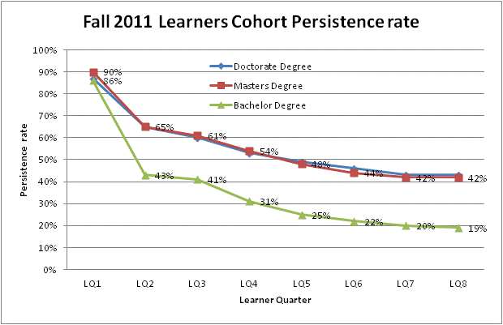

Slide 4
Lead Quality Score - Definition of Success/Persistence
Success is defined as better than average persistence within a degree level. Rigorous definition of target outcome results in improved model validity.
Undergraduate
Masters
Completed first course with a passing grade and has at least one additional quarter of registration, and
Have cumulative GPA greater than or equal to 2.00, and
Have cumulative earned credits equal to or above 50th percentile value (~13 credits) of their cohort class. This takes approximately five quarters.
Have cumulative GPA greater than or equal to 3.00, and
Doctorate/PhD
Have cumulative GPA greater than or equal to 3.00, and
Have cumulative earned credits equal to or above 50th percentile value (~14 credits) of their cohort class. This takes approximately five quarters.
Have cumulative earned credits equal to or above 50th percentile value (~10 credits) of their cohort class. This takes approximately five quarters.

Slide 5
Model Development Process
Model development is a systematic process encapsulating sequence of steps which are mostly iterative depending on model’s outcome.
Model objective
Select Cases
Extract inputs
Validate the input
Repair the input
Transformed the inputs
Apply Model method
Generate deployment methods
Integrate deployment into production
Gather results
Assess observed results
Refine Model objective
~60-70%

Slide 6
Model’s Objective
The primary objective of the LQS is to identify prospective leads likelihood of reaching a success threshold

Slide 7
Selecting Cases: Time Frame
Cases for the LQS model includes all leads that started in Q1 2011 – Q3 2012 cohorts. The decision around this time frame was to have each quarter’s enrollment represented in the sample to avoid seasonality issues if present in enrollment patterns.
Learners in each cohort was track to determine who succeeded and persistent after they enrolled.

Slide 8
Extracting inputs: Data Sources
Social Network
Data (Rapleaf)
Media Interaction
(Next Phase)
Attitude / Motivation
Self-reported data
(Inquiry form)
Experience
Web Engagement Behaviors
(Next Phase)
Zip+4 Geo
Profiling Data
(Census
And Learner Aggregate)
Financial
Preparedness
Data
(Experian)
Ability to Pay/History of Success

Slide 9
Extracting inputs: Dimension reduction
All these variables are funneled through variable reduction process to eliminate redundancies.
Among the many variable reduction methods is Factor analysis.
Failing to remove redundant variables is a serious problem for certain modeling method example Regression. They cause inflation in parameter estimate leading to over fitting and instability of the model for decision making, prediction or ranking. The general statistical term for this redundant problem is multi-co linearity
Factor analysis group correlated input variables into components and extract the components explaining majority of the variability in the underlying data structure,
And selects within each component the dominant variable to represent that component. It’s basically removing redundant variables without any loss of generality in information
Input2
Input1
Input3
Variable reduction process
Remaining Variables: Input1 & 2

Slide 10

Extracting inputs: Remove irrelevant inputs
After removing redundant variables, the next step in input extraction is to remove irrelevant inputs with no relation to model’s objective.
This stage is not so critical as most of the modeling algorithms have built in processes to isolate irrelevant input variables.
Example: Regression’s stepwise/forward and backward options remove irrelevant variables unrelated to model’s objective. Decision tree also uses logworth criteria to eliminate irrelevant inputs
Nonetheless, I perform spearman and hoeffding univariate correlation analysis of each input with target and eliminate inputs agreed by spearman and hoeffding correlation measures as ranking very low in relation to target.

Slide 11
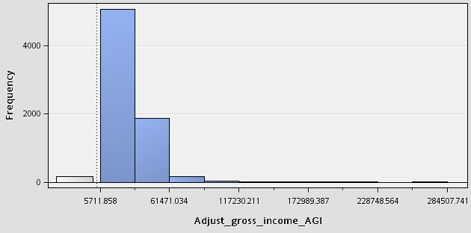
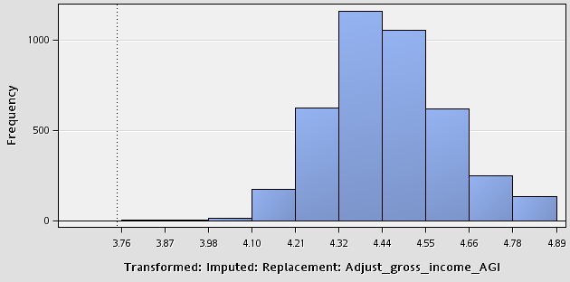
Explore/Validate and Repair selected inputs
This stage involved understanding underlying distribution of each selected inputs and repairing them accordingly for:-
Normality, uniformity and skewness,
Standard deviation of inputs to detect outlying data points,
And treatment of missing data points. Certain modeling algorithms are very sensitive to these issues e.g. Regression and Neural Network.
Outlying data points
Cap outliers three standard deviation from mean
Median imputation to replace missing values
Apply Log to base 10 transformation to normalize the data
Missing data points
Right skewed distribution
Before repairs
After repairs and Transformation

Slide 12
Splitting Modeling Dataset
Split the modeling dataset into two part:-
Training - This dataset is used to estimate the model’s parameters
Validation - This is an independent dataset to test and calibrate the parameter estimate and also used to select the ultimate model using fit statistics on the validation dataset.
There should be little separation between the training estimates and the validation estimates. Huge separation is an indication of model over fitting
Validation Sample in LQS ~ 45%
Training Sample in LQS ~ 55%

Slide 13
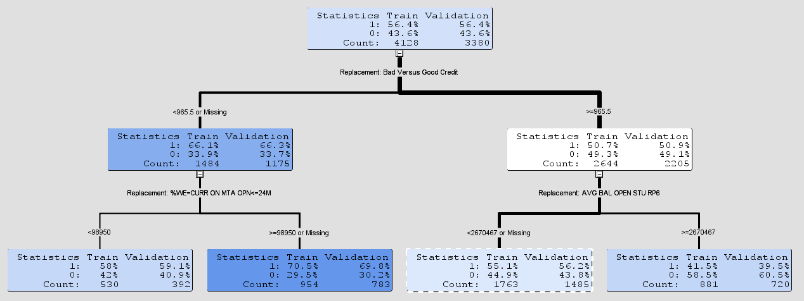

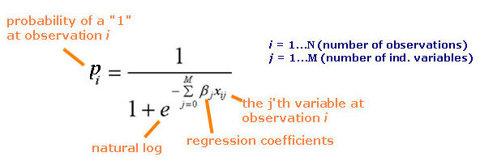
Apply appropriate modeling method
I explored two modeling methods for the LQS .
Decision Tree Model – Produces prediction rules , e.g.
Logistic Regression Model - Produces a prediction formula
E.g.. Prediction Estimate =
Logit link Function =

Slide 14
Apply appropriate modeling method: Cont’d
Logistic Regression prediction equation
Score=
1/(1+1/EXP( -0.3061 +
PCTL_IMP_REP_Zip3Hist_FCS *0.27380087 +
PCTL_IMP_REP_time_to_start_days * 2.14603878 +
PCTL_IMP_REP_recent_Months_Since * 1.08856291 +
PCTL_IMP_REP_bad_versus_good_cre * -0.28203980 +
PCTL_IMP_REP_avg_mpmt_open_stu_r * -0.29473888 +
PCTL_IMP_REP_Age_at_inq * 0.01516530 +
PCTL_IMP_REP_avg_rtr_ever_90_ * 0.00001567 +
));

Slide 15
Apply appropriate modeling method: Cont’d
Logistic Regression Model with stepwise variable selection criteria process
Inputs
No: fails 95% entry significance level test
Meet entry test
Yes: pass 95% entry Significance level test
Rejected
Enter Input1
Enter Input2, & etc…
Input1 stay or leave given input2 presence
Stay: if passes 95% stay Significance level test

Slide 16
Apply appropriate modeling method: Cont’d
Compare Fit Statistics of the two models on validation dataset.
Logistic Regression
Decision Tree
Fit statistics is a statistical measure of model performance
My favorite Fit statistics in model selection
Misclassification rates :- The proportion of disagreement between prediction and outcome. Lower values are desirable.
Average Square error: Squared difference between predicted and actual outcome and average over all cases. Lower values are desirable
Picked the model method with the lowest Fit statistics to deploy
Logistic Regression won
 | Misclassification rate |  | Average Square Error
 | Logistic Regression | Decision Tree | Logistic Regression | Decision Tree
PhD | 32% | 38% | 0.2210 | 0.2833
MS | 31% | 35% | 0.2102 | 0.3360
BS | 33% | 40% | 0.2310 | 0.2933

Slide 17
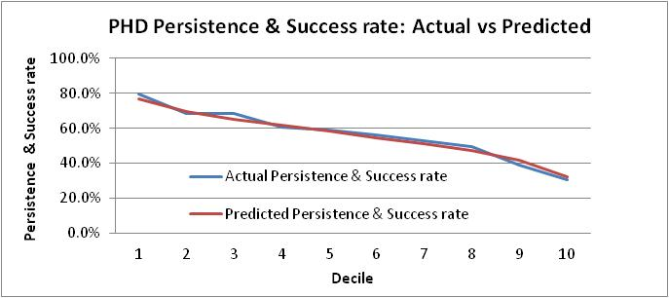
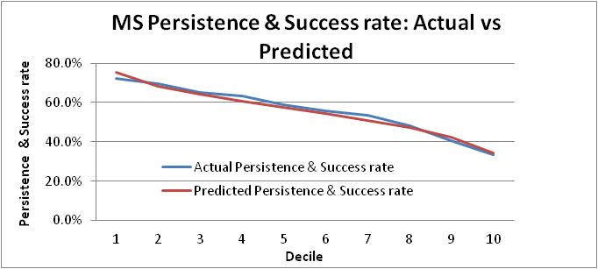
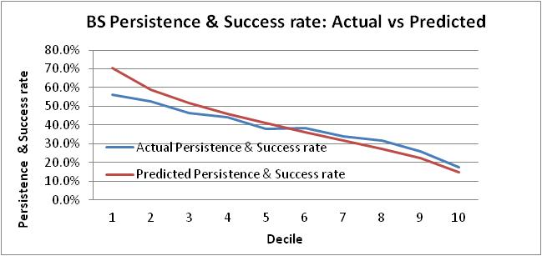
Model Results – Segment ranking
Quality Leads
Less Quality leads
Quality Leads
Less Quality leads
Prediction and Actual are very much aligned
Adequate separation of persistence and success rate across each segment
Quality Leads
Less Quality leads

Slide 18
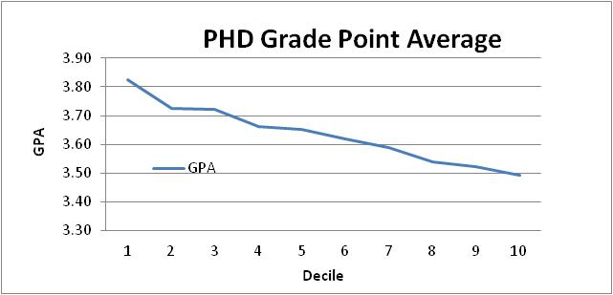
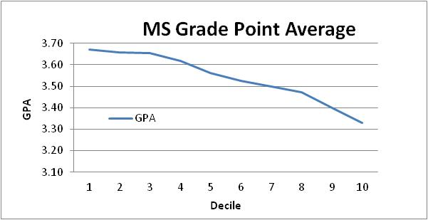
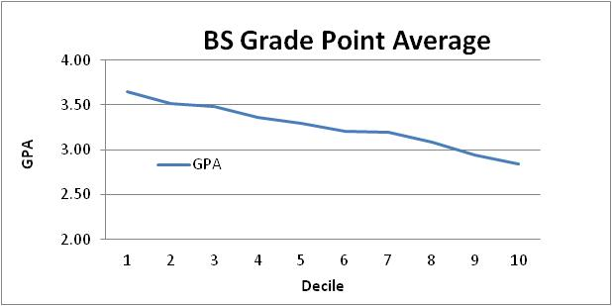
Model Results – Segment ranking: GPA
Quality Leads
Less Quality Leads
Quality Leads
Less Quality Leads
GPA ranks as expected
Quality Leads
Less Quality Leads

Slide 19
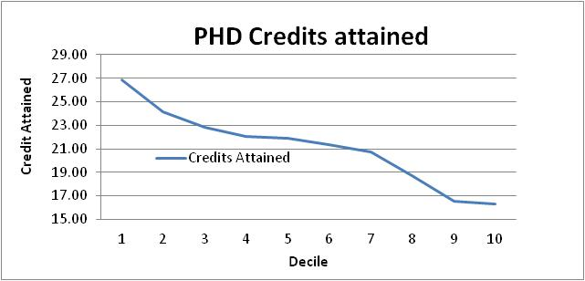
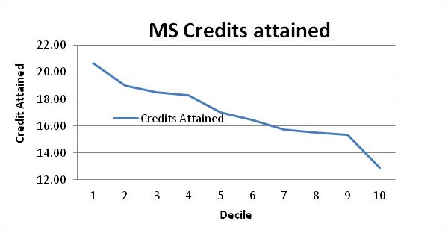
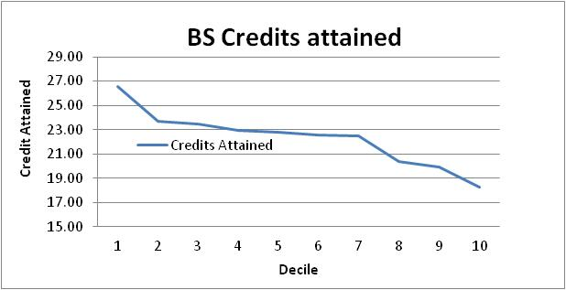
Model Results – Segment ranking: Credit Attain
Quality Leads
Less Quality Leads
Quality Leads
Less Quality Leads
Credit Attained ranks as expected
Quality Leads
Less Quality Leads

Slide 20
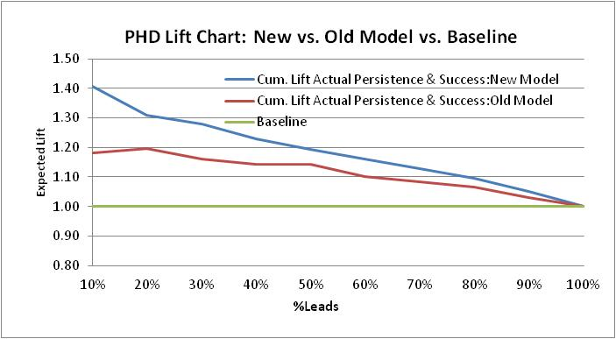
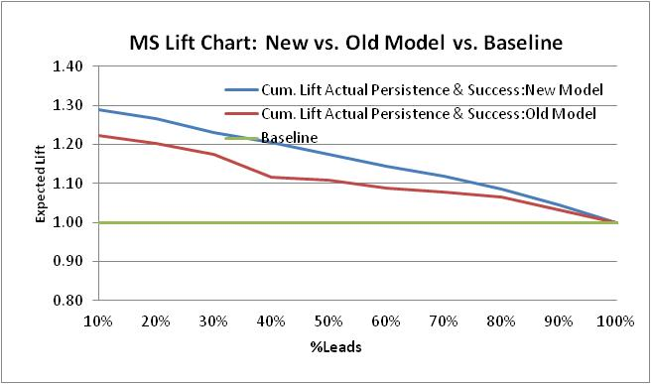
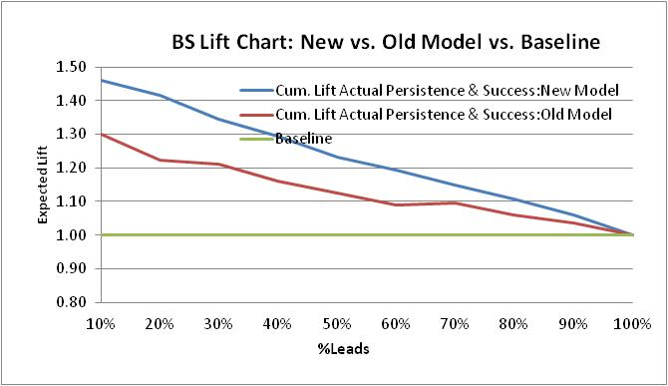
Model Results – Cumulative lift chart
PhD model shows moderate lift of about 7%
MS model shows moderate lift of about 5%
BS model shows moderate lift of about 10%

Slide 21
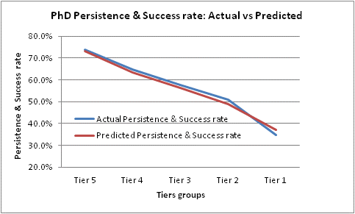
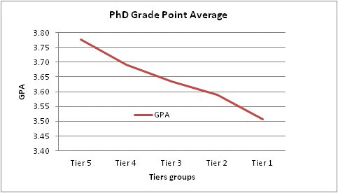
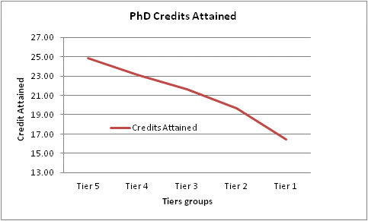
Lead Quality Score Results
Improvements in accuracy vs. retiring model.
Prediction and Actual are very much aligned
Approx. 70% accuracy in prediction
Ranks multiple key academic success measures
PhD model shows moderate lift of about 7%
MS model shows moderate lift of about 5%
BS model shows moderate lift of about 10%

Slide 22
Insights about High Quality Prospects
The model describes a quality PhD prospective learner as one most likely:-
To be carrying low student loans balances/debt
Living in a geographic areas where Capella learners historically have higher first course success rates
Has longer than average consideration window (usually 60 to 120 days)
Married, longer length of residence, and household income between 60 – 100k
Geo area with high proportions of dislocated workers, private college attendance, and interest in work-study programs
The model describes a quality MS prospective learner as one most likely:-
Has longer than average consideration window (usually 90 to180 days)
Living in a geographic areas where Capella learners historically have higher First course success rate
Never delinquent /derogatory on Student loans payment and has lower student loan debt
Limited interested in online Social Networking activities, and live in a predominately white neighborhoods
The model describes a quality BS prospective learner as one most likely:-
Has longer than average consideration window (usually 30 to 60 days)
Never delinquent /derogatory on student loans payment, and has good credit
Living in a geographic areas where Capella learners historically have higher assignment completion rates
To be older women living in a predominately white neighborhoods
Relatively shorter time window since their most recent education attendance (less then 5years)

Slide 23
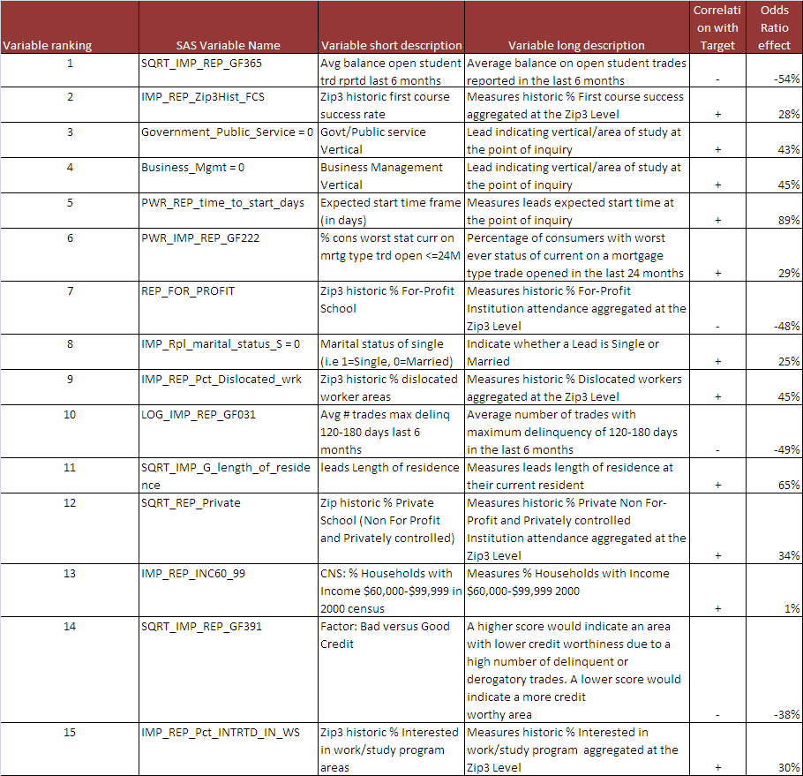
Modeling Results – Variables effect and importance: PHD

Slide 24
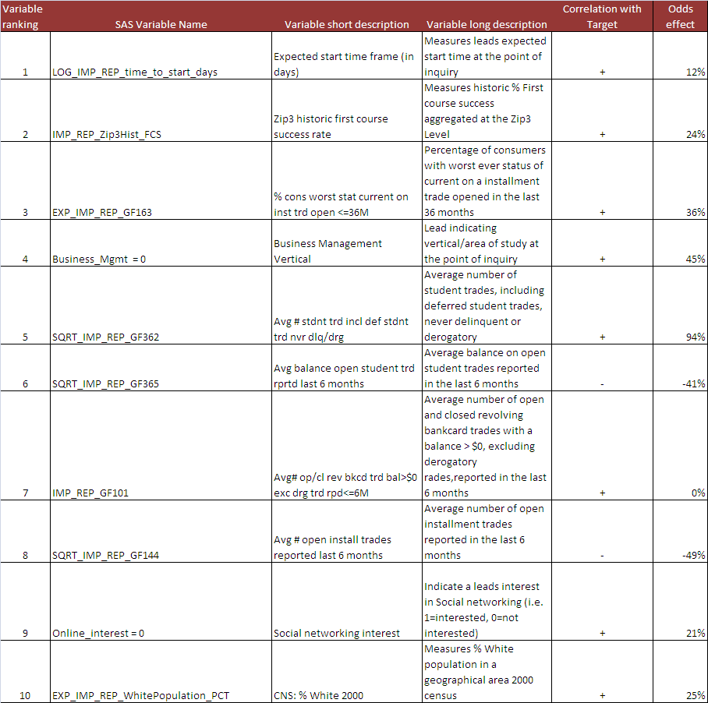
Modeling Results – Variables effect and importance: MS

Slide 25
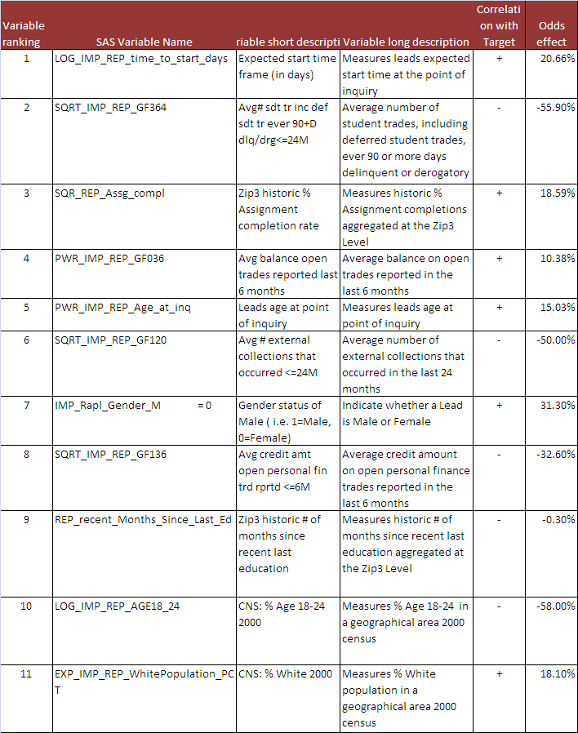
Modeling Results – Variables effect and importance: BS

Slide 26
How a lead is scored in Seahawk
Experian credit summarized data request via API
Rapleaf demographic & social Network data request via API
Lead Processing Engine a.k.a Seahawk
Scoring Algorithm
Probability scores
Segmented probability scores e.g. deciles
Inquirer Request
Zip historic files
Census data

Slide 27
Appendix
Appendix

Slide 28
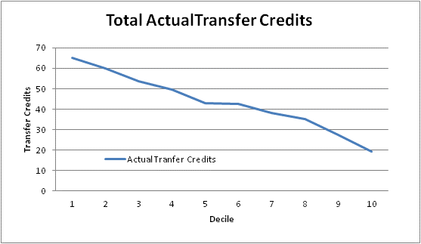
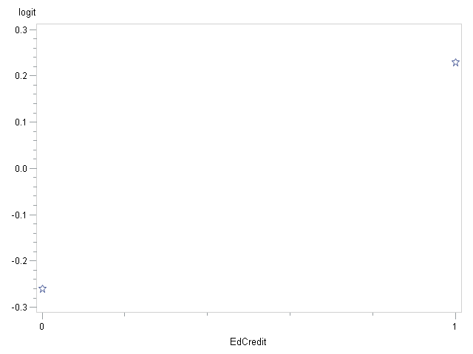
Appendix– Transfer Credit
Estimated Logit Plot of EdCredit (Education Credits)
Persistence & Success
0.229
-0.261
Quality Leads
Less Quality Leads
Actual Transfer credits reported at point of admission
Clear separation of Transfer credits across each segment
Self reported Education credited at point of inquiry
Clear indication of positive linear correlation with persistence and success rate

Slide 29
Lead Color
Lead Counts by Color Bucket – Proposed Outbound Prioritization Framework
Lead Color Logic – available in dialer since Oct 13.
 | high
Success | medium
 | low
 |  | low | medium | high
 |  |  | Conversion
Increased Attempts
Fewer Attempts
lead color | lead count | lead % | ltr | lsm | enroll | i-e conversion
RED | 16,167 | 15% | $ 1,262 | 61% | 802 | 5.0%
KHAKI | 55,082 | 50% | $ 609 | 50% | 2,163 | 3.9%
PURPLE | 28,751 | 26% | $ 85 | 51% | 136 | 0.5%
BLUE | 9,879 | 9% | $ 167 | 38% | 178 | 1.8%
 | 109,879 |  |  |  | 3,279 | 3.0%

Slide 30
LQS Application: Aggregator Publisher Ranking
Decreasing Marketing Return on Investment
Increase volume and raise bid on publishers with higher quality leads and showing higher mROI’s
Maintain Publishers generating moderate lead quality score and moderate mROI’s
Lower bid, Increase rejects and/or Cut Publishers generating low quality leads and showing lower mROI
Increase Volume/Raise Bid
Decreasing lead quality score
Maintain
Lower Bid/Increase Reject/Cut

Slide 31
Exercise: Aggregator Optimization using CLC sample data
Publisher | Inq Volume | MROI | LQS Tier 4&5 | IE_90 Rate | Strategy
U.S. News University Connection, LLC | 1,503 | 2.23 | 35.0% | 1.2% | Increase Volume/Raise Bid
Monster Worldwide | 3,886 | 2.15 | 31.8% | 0.4% | Increase Volume/Selective Reject
CollegeDegrees.com, LLC | 12,027 | 1.89 | 37.4% | 0.9% | Increase Volume/Raise Bid
XYZ Media Inc. | 2,348 | 1.53 | 41.7% | 1.4% | Increase Volume/Raise Bid
Ampush Media, Inc. | 3,713 | 1.34 | 34.1% | 0.3% | Maintain
Education Dynamics | 29,553 | 1.33 | 31.3% | 0.9% | Maintain
LendingTree, LLC | 2,583 | 1.32 | 35.9% | 0.3% | Maintain
Reach Network, Inc. | 1,844 | 1.28 | 33.0% | 2.9% | Maintain
All Star Directories | 3,713 | 1.17 | 38.9% | 0.6% | Maintain
Lead Media Partners, LLC | 3,154 | 1.15 | 34.7% | 0.3% | Maintain
LGTechNet | 1,026 | 1.09 | 25.5% | 0.3% | Lower Bid/Selective Reject
CUnet, LLC | 4,355 | 1.02 | 34.8% | 0.8% | Lower Bid
Remilon, LLC | 4,383 | 0.99 | 38.5% | 1.8% | Lower Bid/Raise Bid?
ClassesUSA | 2,265 | 0.91 | 34.9% | 0.3% | Lower Bid
Vantage Media LLC | 1,248 | 0.82 | 40.2% | 0.7% | Lower Bid/Raise Bid?
Adchemy, Inc. | 583 | 0.61 | 33.3% | 0.4% | Cut
Quinstreet | 2,101 | 0.41 | 31.8% | 0.7% | Cut
Alloy Media & Marketing | 3,713 | 0.37 | 23.1% | 0.1% | Cut
 |  | 1.20 | 34.2% | 0.8%

Slide 32
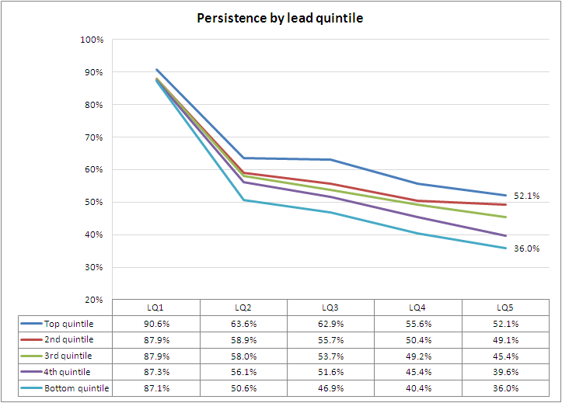
LQS Quintile Performance – Validation

Slide 33
Appendix– Dependent variable definition
No apparent significant changes in PhD & MS Persistent definition
Slight change at the BS level with inclusion of credit limit attainment
The change is warranted

